Slide 1


Apparel Arcade
This Project & Presentation is for partial fulfilment of
Front End Engineering - II(22CS004)
Submitted By :
CSE-G30(Team 07)
Lisha Goel (2210990542)
Keshav Gupta(2210990505)
Kushagra Juneja (2210990533)
Presented To :
Dr. Rajender Kumar
Department of Computer Science and Engineering
Chitkara University, Punjab

Slide 2

Table of content
Introduction
3
Meet our Team
5
Technical Details
6
Key Features
7
Project Highlight
8
Future Goals
16
Conclusion
17

Slide 3
Introduction
Welcome to Shopper, your premier destination for online shopping of latest fashion trends. At Shopper, we pride ourselves on offering a curated selection of high-quality products from top brands and trusted sellers. With our user-friendly interface and secure payment options, shopping with us is convenient, safe, and hassle-free.
Why choose Shopper? Here are just a few reasons:
Extensive Product Range
Quality Assurance
Convenient Shopping Experience
Secure Transactions
Fast Shipping and Reliable Delivery
Exceptional Customer Service
Experience the convenience of online shopping with Shopper. Start browsing now and discover a world of possibilities at your fingertips!
Happy shopping!
Shopper Team

Slide 4


Apparel arcade

Slide 5




Meet OUR team
KUSHAGRA JUNEJA
LISHA GOEL
KESHAV GUPTA
HTML and CSS
ReactJS
Website designing

Slide 6
Technical Details
HTML :
The Hypertext Markup Language or HTML is standard markup language for documents designed to be displayed in a web browser.
CSS :
CSS or cascading style sheets is used for styling and formatting HTML documents. It is used to define styles for HTML elements such as fonts, colors, spacing and layout.
REACTJS :
React.js is a powerful JavaScript library used for building user interfaces, particularly for web applications with dynamic content.
VISUAL STUDIO CODE :
Visual studio code is a free and open-source code editor developed by Microsoft and is designed for building and debugging web and cloud applications.
API :
An API, or Application Programming Interface, is a set of rules and protocols that allows different software applications to communicate with each other

Slide 7
Key Features
WIDE SELECTION :
Explore a diverse range of products carefully curated to cater to your every need and desire.
QUALITY GUARANTEE :
We partner with reputable suppliers and brands to ensure that every item you purchase meets our high standards of quality and authenticity
SEAMLESS SHOPPING EXPERIENCE:
Our intuitive website design and secure payment gateways make shopping with us a hassle-free affair.
SWIFT DELIVERY:
Say goodbye to long waits. We prioritize fast shipping to get your purchases to your doorstep in the shortest time possible.
DEDICATED SUPPORT:
Have a question or need assistance? Our friendly customer support team is always ready to lend a helping hand

Slide 8

SHOPPER
Project Highlights

Slide 9
INTUITIVE USER INTERFACE:
Designed a modern and intuitive user interface that enhances usability and encourages conversion, resulting in a user-friendly browsing and shopping experience.
RESPONSIVE DESIGN:
Implemented a responsive design approach to ensure optimal performance and consistency across all devices, including desktops, tablets, and smartphones..
PRODUCT DISCOVERY:
Enhanced product discovery with advanced search functionality, filters, and sorting options, enabling customers to easily find the products they're looking for.
STREAMLINED CHECKOUT PROCESS:
Optimized the checkout process for simplicity and efficiency, reducing cart abandonment rates and increasing conversion rates.
SECURE PAYMENTS:
Integrated secure payment gateways such as Stripe and PayPal to offer multiple payment options and ensure the safety of customer transactions.

Slide 10
PERSONALIZED RECOMMENDATIONS:
Implemented personalized product recommendations based on customer browsing and purchase history, enhancing cross-selling and upselling opportunities.
INVENTORY MANAGEMENT:
Developed robust inventory management tools for merchants to track stock levels, manage product variants, and receive notifications for low inventory levels.
ORDER FULFILLMENT:
Streamlined order fulfillment processes with automated order processing, shipment tracking, and order status updates, improving efficiency and customer satisfaction.
CUSTOMER SUPPORT:
Implemented live chat support and a comprehensive help center to provide timely assistance and address customer inquiries, leading to improved customer satisfaction and retention.
ANALYTICS AND INSIGHTS:
Integrated analytics and reporting tools to provide merchants with valuable insights into sales performance, customer behavior, and marketing effectiveness, enabling data-driven decision-making.

Slide 11
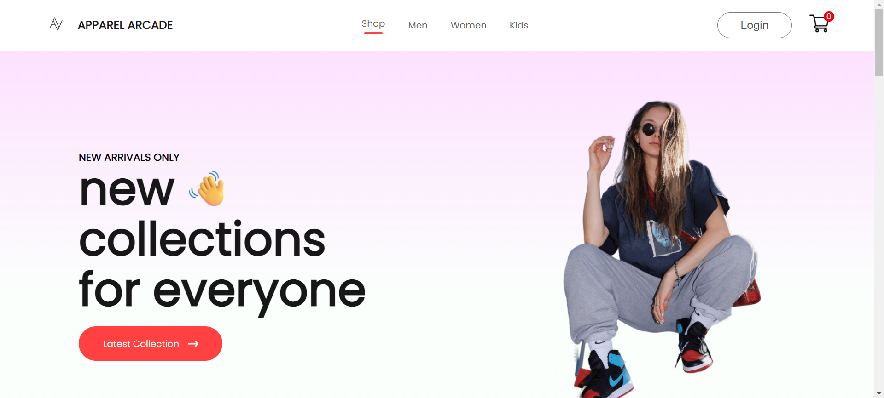

Slide 12
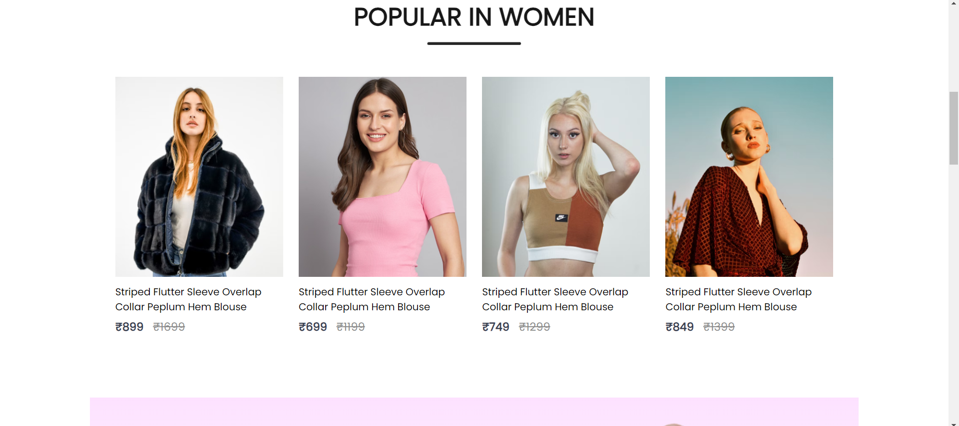

Slide 13
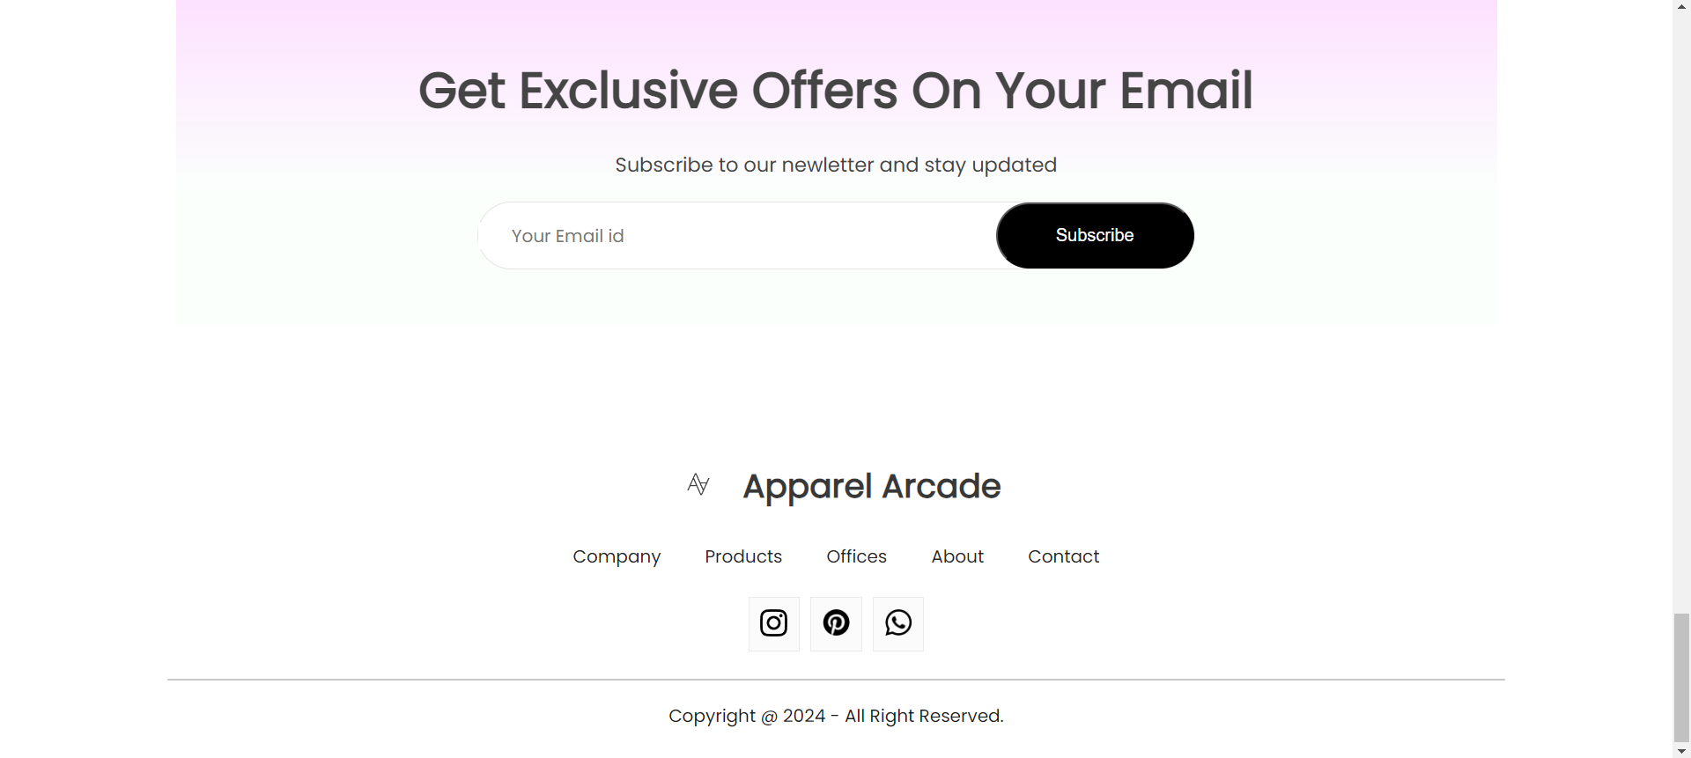

Slide 14
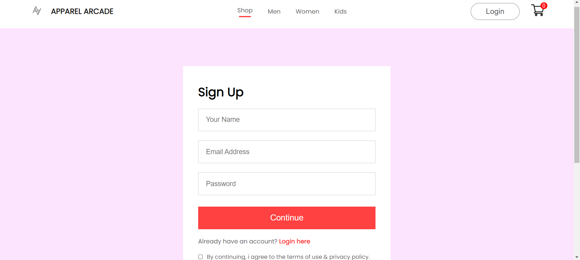

Slide 15
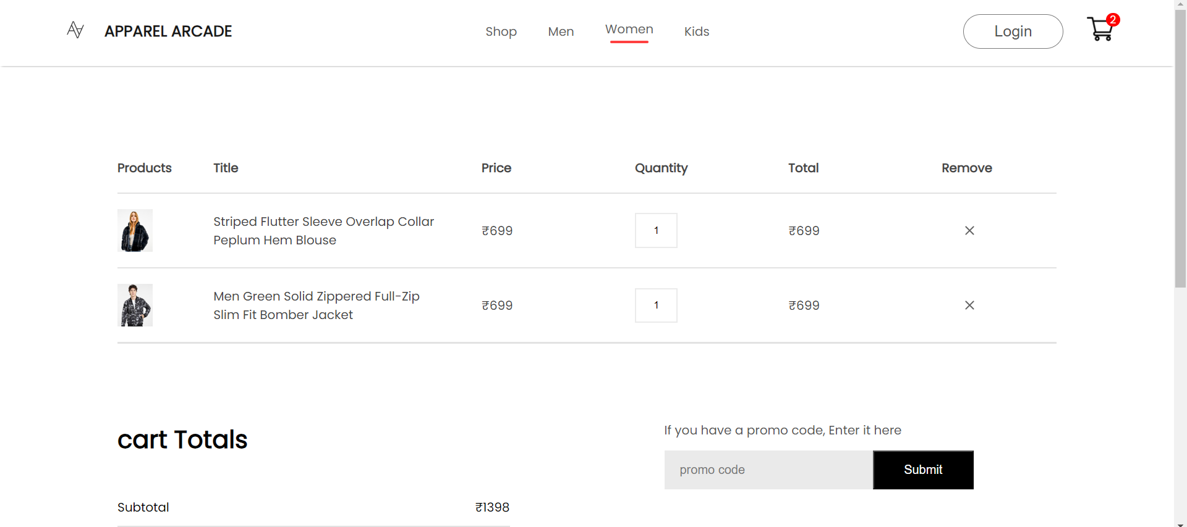

Slide 16
Future Scope
BLOCKCHAIN TECHNOLOGY:
Blockchain technology has the potential to revolutionize eCommerce by providing transparent and secure transactional systems. Implementing blockchain-based solutions for supply chain management, product authentication, and payment processing can enhance trust and transparency in eCommerce transactions.
SUBSCRIPTION SERVICES:
Subscription-based eCommerce models, such as subscription boxes and recurring delivery services, are gaining popularity. eCommerce websites can capitalize on this trend by offering subscription options for products and services, providing convenience and value to customers while generating recurring revenue streams.
GLOBAL EXPANSION:
As eCommerce continues to transcend geographical boundaries, eCommerce websites will increasingly focus on global expansion. Localizing websites for different languages and cultures, offering international shipping options, and complying with local regulations will be essential for tapping into new markets and reaching a diverse customer base.

Slide 17
Conclusion
Overall, the future of eCommerce websites is dynamic and multifaceted, driven by technological innovation, changing consumer preferences, and evolving market dynamics. By embracing emerging trends and adopting innovative strategies, eCommerce websites can stay ahead of the curve and unlock new opportunities for growth and success.

Slide 18
Thank You!!

